Slide 1
Unit 2 – Process Management
Additional Contents

Slide 2
Process Concept
Program is passive entity stored on disk (executable file), process is active
Program becomes process when executable file loaded into memory
Execution of program started via GUI mouse clicks, command line entry of its name, etc
One program can be several processes
Consider multiple users executing the same program

Slide 3
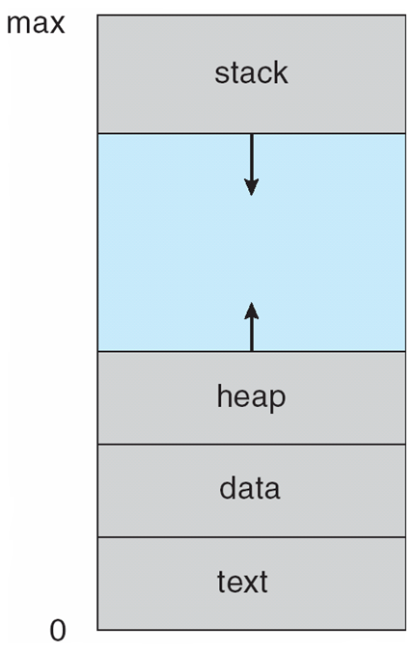
Process Concept (contd.)

Slide 4
Schedulers
Short-term scheduler (or CPU scheduler) – selects which process should be executed next and allocates CPU
Sometimes the only scheduler in a system
Short-term scheduler is invoked frequently (milliseconds) ⇒ (must be fast)
Long-term scheduler (or job scheduler) – selects which processes should be brought into the ready queue
Long-term scheduler is invoked infrequently (seconds, minutes) ⇒ (may be slow)
The long-term scheduler controls the degree of multiprogramming
Processes can be described as either:
I/O-bound process – spends more time doing I/O than computations, many short CPU bursts
CPU-bound process – spends more time doing computations; few very long CPU bursts
Long-term scheduler strives for good process mix

Slide 5
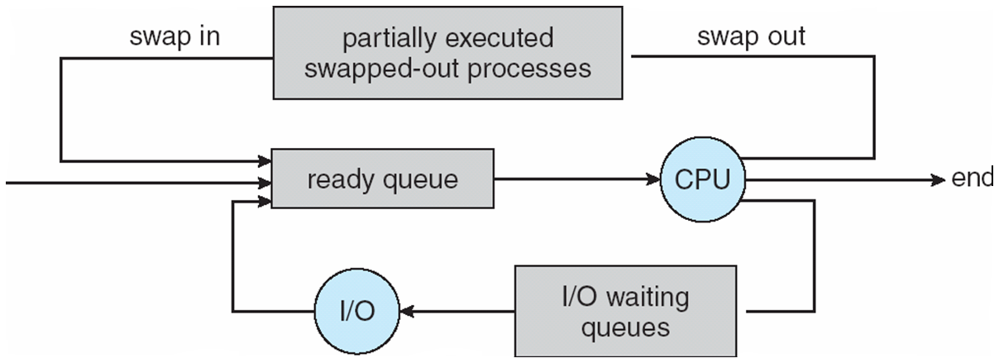
Schedulers (contd.)
Medium-term scheduler can be added if degree of multiple programming needs to decrease
Remove process from memory, store on disk, bring back in from disk to continue execution: swapping

Slide 6
Process Creation
Parent process create children processes, which, in turn create other processes, forming a tree of processes
Generally, process identified and managed via a process identifier (pid)
Resource sharing options
Parent and children share all resources
Children share subset of parent’s resources
Parent and child share no resources
Execution options
Parent and children execute concurrently
Parent waits until children terminate

Slide 7
A tree of process

Slide 8
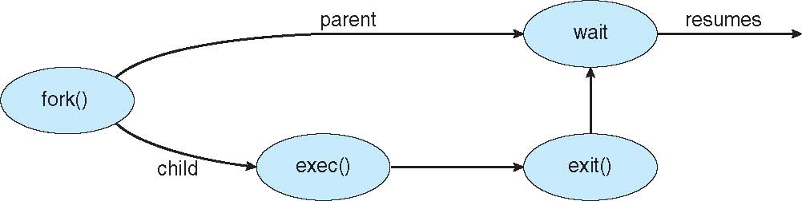
Process Creation (Cont.)
Address space creation
Child is a duplicate of parent
Child has a new program loaded into it
UNIX examples
fork() system call creates new process
exec() system call used after a fork() to replace the process’ memory space with a new program

Slide 9

C Program Forking Separate Process

Slide 10
Process Termination
Process executes last statement and then asks the operating system to delete it using the exit() system call.
Returns status data from child to parent (via wait())
Process’ resources are deallocated by operating system
Parent may terminate the execution of children processes using the abort() system call. Some reasons for doing so:
Child has exceeded allocated resources
Task assigned to child is no longer required
The parent is exiting and the operating systems does not allow a child to continue if its parent terminates

Slide 11
Process Termination
Some operating systems do not allow child to exists if its parent has terminated. If a process terminates, then all its children must also be terminated.
cascading termination. All children, grandchildren, etc. are terminated.
The termination is initiated by the operating system.
The parent process may wait for termination of a child process by using the wait()system call. The call returns status information and the pid of the terminated process
pid = wait(&status);
If no parent waiting (did not invoke wait()) process is a zombie
If parent terminated without invoking wait , process is an orphan

Slide 12
Single and Multithreaded Processes

Slide 13
Pthreads
May be provided either as user-level or kernel-level
A POSIX standard (IEEE 1003.1c) API for thread creation and synchronization
Specification, not implementation
API specifies behavior of the thread library, implementation is up to development of the library
Common in UNIX operating systems (Solaris, Linux, Mac OS X)

Slide 14
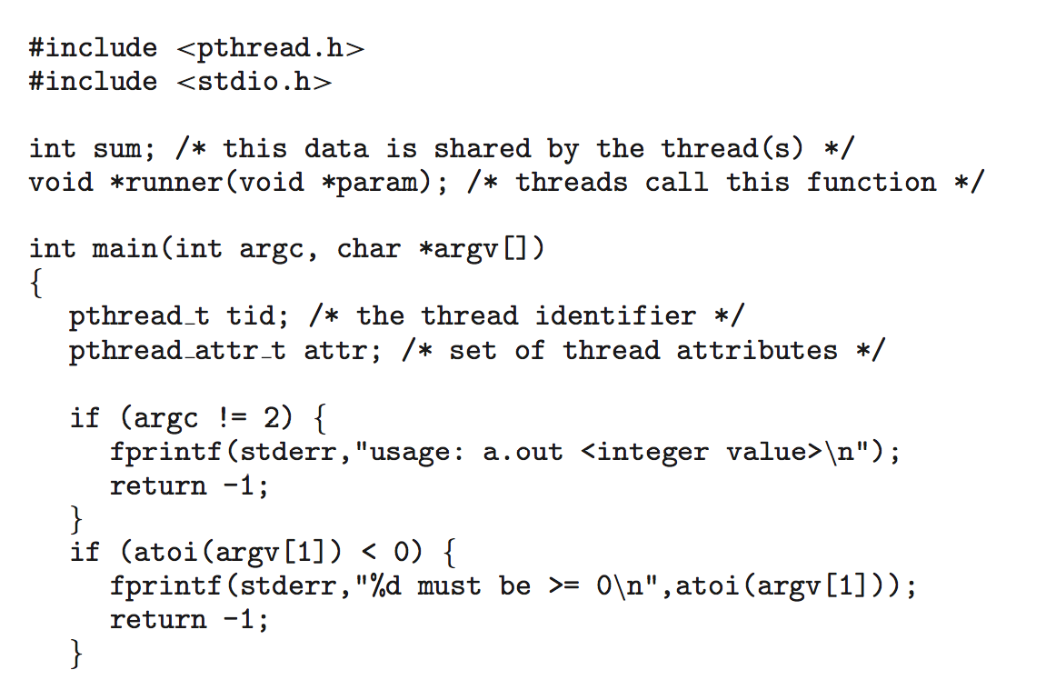
Pthreads - Example

Slide 15
Pthreads Example (Cont.)

Slide 16
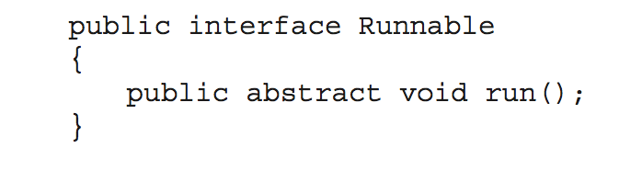
Java Threads
Java threads are managed by the JVM
Typically implemented using the threads model provided by underlying OS
Java threads may be created by:
Extending Thread class
Implementing the Runnable interface

Slide 17
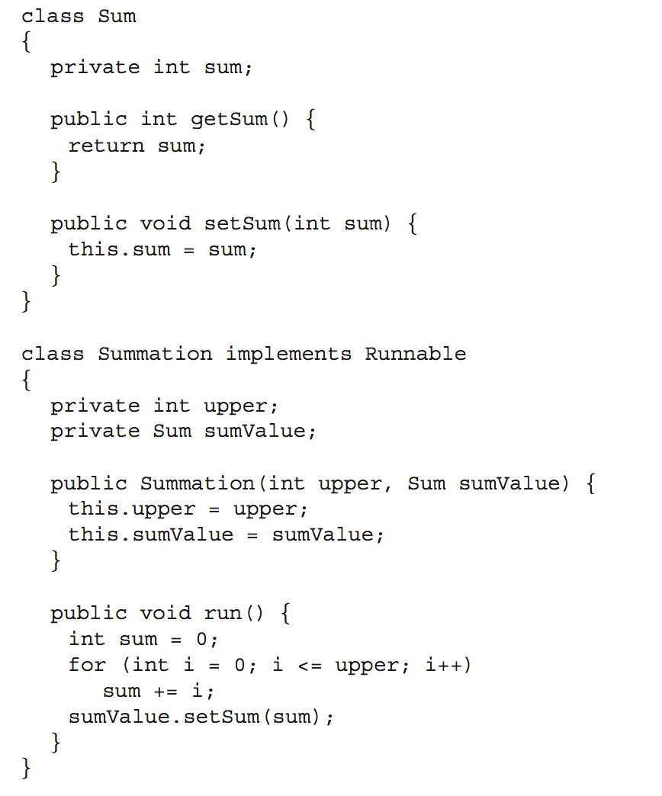
Java Multithreaded Program

Slide 18
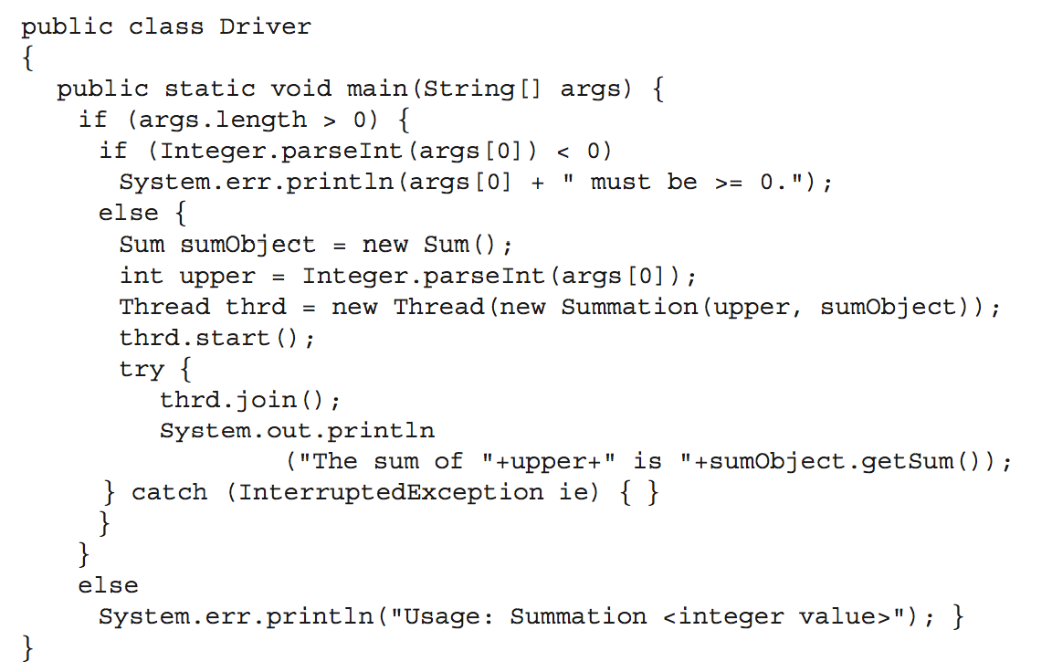
Java Multithreaded Program (Cont.)

Slide 19
Semaphore
Synchronization tool that provides more sophisticated ways (than Mutex locks) for process to synchronize their activities.
Semaphore S – integer variable
Can only be accessed via two indivisible (atomic) operations
wait() and signal()
Originally called P() and V()
Definition of the wait() operation
wait(S) {
while (S <= 0)
; // busy wait
S--;
}
Definition of the signal() operation
signal(S) {
S++;
}

Slide 20
Semaphore Usage
Counting semaphore – integer value can range over an unrestricted domain
Binary semaphore – integer value can range only between 0 and 1
Same as a mutex lock
Can solve various synchronization problems
Consider P₁ and P₂ that require S₁ to happen before S₂
Create a semaphore “synch” initialized to 0
P1:
S₁;
signal(synch);
P2:
wait(synch);
S₂;
Can implement a counting semaphore S as a binary semaphore

Slide 21
Semaphore Implementation
Must guarantee that no two processes can execute the wait() and signal() on the same semaphore at the same time
Thus, the implementation becomes the critical section problem where the wait and signal code are placed in the critical section
Could now have busy waiting in critical section implementation
But implementation code is short
Little busy waiting if critical section rarely occupied
Note that applications may spend lots of time in critical sections and therefore this is not a good solution

Slide 22
Semaphore Implementation with no Busy waiting
With each semaphore there is an associated waiting queue
Each entry in a waiting queue has two data items:
value (of type integer)
pointer to next record in the list
Two operations:
block – place the process invoking the operation on the appropriate waiting queue
wakeup – remove one of processes in the waiting queue and place it in the ready queue
typedef struct{
int value;
struct process *list;
} semaphore;

Slide 23
Implementation with no Busy waiting (Cont.)
wait(semaphore *S) {
S->value--;
if (S->value < 0) { add this process to S->list;
block();
}
}
signal(semaphore *S) {
S->value++;
if (S->value <= 0) { remove a process P from S->list;
wakeup(P);
}
}

Slide 24
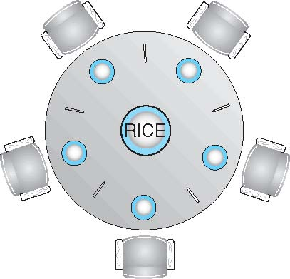
Dining-Philosophers Problem
Philosophers spend their lives alternating thinking and eating
Don’t interact with their neighbors, occasionally try to pick up 2 chopsticks (one at a time) to eat from bowl
Need both to eat, then release both when done
In the case of 5 philosophers
Shared data
Bowl of rice (data set)
Semaphore chopstick [5] initialized to 1

Slide 25
Dining-Philosophers Problem Algorithm
The structure of Philosopher i:
do {
wait (chopstick[i] );
wait (chopStick[ (i + 1) % 5] );
// eat
signal (chopstick[i] );
signal (chopstick[ (i + 1) % 5] );
// think
} while (TRUE);
What is the problem with this algorithm?

Slide 26
Dining-Philosophers Problem Algorithm (Cont.)
Deadlock handling
Allow at most 4 philosophers to be sitting simultaneously at the table.
Allow a philosopher to pick up the forks only if both are available (picking must be done in a critical section.
Use an asymmetric solution -- an odd-numbered philosopher picks up first the left chopstick and then the right chopstick. Even-numbered philosopher picks up first the right chopstick and then the left chopstick.

Slide 27
Monitors
A high-level abstraction that provides a convenient and effective mechanism for process synchronization
Abstract data type, internal variables only accessible by code within the procedure
Only one process may be active within the monitor at a time
But not powerful enough to model some synchronization schemes
monitor monitor-name
{
// shared variable declarations
procedure P1 (…) { …. }
procedure Pn (…) {……}
Initialization code (…) { … }
}
}

Slide 28
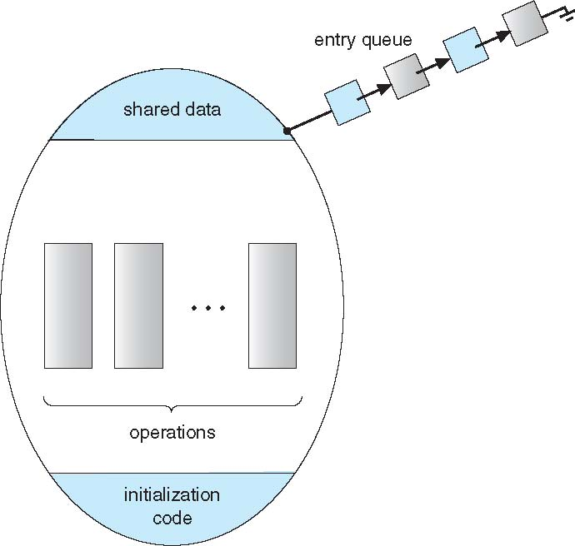
Schematic view of a Monitor

